Slide 1
Tribal Renewable Energy Project Development and Financing Essentials
Notes:
Thank you for attending today’s presentation of Tribal Renewable Energy Project Development and Financing Essentials.
This course covers the basics of the project development process and financing options for Tribes, and key terminology used in the field of renewable energy project development.

Slide 2
Introduction
The U.S. Department of Energy (DOE) Office of Indian Energy Policy and Programs is responsible for assisting Tribes with energy planning and development, infrastructure, energy costs, and electrification of Indian lands and homes.
As part of this commitment and on behalf of DOE, the Office of Indian Energy is leading education and capacity building efforts in Indian Country.
Notes:
The idea for this training came from feedback from tribal leadership, tribal organizations, and other entities interested or involved in energy development in Indian Country.

Slide 3
Why Complete a Renewable Energy Project?
Income
Jobs
Experience
Cost savings
Cost stabilization
Tax revenue
Industry exposure
Energy reliability
Self reliance
Environmental sustainability
Benefits vary based on the type and scale of project
Notes:
Before we get started, I want to take a minute to talk about why you may be here: the benefits of tribal renewable energy development
There are a variety of benefits, and the extent to which they can be reaped depends on the scale and type of project.
Often times we can prioritize project types based on goals – that is, we know that if the goal is increased income – then you are likely targeting a revenue-generating project, as opposed to a facility-scale project.
Accessing these benefits is why we are really here today – we know we can use renewable energy to obtain these benefits, and we are going to talk at length about how to get those projects going.

Slide 4
Agenda
Overview of webinar purpose and structure
Project development and financing key concepts (addressed in context)
Project development process and decision points
Notes:
To accomplish that goal, I am going to talk through a quick overview of the training program and the structure of the program
Then I will talk about the critical concepts that you need to be familiar with in order to develop projects on your lands or with your resources, and
I will go through a brief chronological project development process and identify key decision points for project leaders.

Slide 5
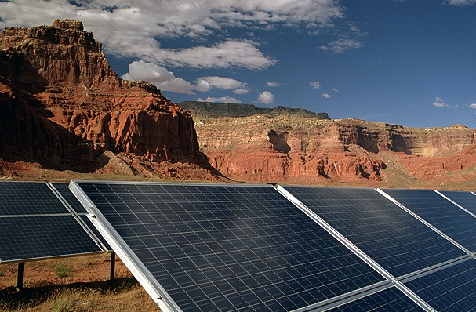
Project Development And Financing WEBINAR Overview: Purpose and Structure
Notes:
Now for a quick overview of the training program and structure.

Slide 6
Purpose of Webinar
Provide a framework for renewable energy project development and financing for Tribes
Set and manage expectations of project development
Identify decision points and the information needed to effectively make decisions
Pinpoint available tools for use in project development
Provide examples of relevant projects
Notes:
The intention of the course is to give you the context, confidence, and capability to make decisions regarding the development of renewable energy on tribal lands.
To do that we focus on a framework to help make those decisions, what you can expect from the process, what decisions will need to be made and who should make them, and identify tools that are available for you to use to make decisions.

Slide 7
Course Audiences
Tribal Leaders
Staff/Project Management
Primary decision makers
Understand terminology
Understand key decision points and influencing factors
May be self-managing project or managing consultants
Communicate at key points with decision makers
Require in-depth knowledge of process
Notes:
The courses are designed for two audiences
tribal leaders, who are the decision makers, and
tribal staff and project managers.
Tribal leaders really need to understand the process and where decisions need to be made in order to keep projects moving.
Staff need that same information, and also what additional details need to be developed in order to facilitate the decision maker’s ability to make those key decisions.

Slide 8
How This “Essentials” Course Fits
Essentials
Basic process, decisions, and concepts for project development
Audience: All involved in project
Facility
Comprehensive, in-depth process pathways for facility-scale project development and financing
Audience: Decision makers and project and contract managers
Community
Comprehensive, in-depth process pathways for community-scale project development and financing
Audience: Decision makers and project and contract managers
Advanced/In-Depth
Detailed academic information for deep understanding of concepts
Audience: Project and contract managers
Commercial
Comprehensive, in-depth process pathways for commercial-scale project development and financing
Audience: Decision makers and project and contract managers
Notes:
To accomplish the training goals, we’ve broken the information into a manageable course structure:
1) the essentials – that is what you are here for today. In the essentials, you will get an overview of the terminology as well as the process. We’ll talk about rough timelines, appropriate expectations for project development, and the process for development. We also talk about tools that are available to support decision making.
2) the advanced courses offer extensive conceptual details on development and financing structures.
3) The training also provides more detail on each SCALE of facility. There are a variety of differences between developing projects of different sizes – whether you are looking to put in a single system to contribute power to a building, set up community power, or develop a large utility-scale generation system – there are differences both in how you approach development and in how it’s financed and executed. This series of courses provides a hypothetical walkthrough of the development of a project – with the important decision points and expectations for development.
We set it up this way so that people could self select the courses that are important to them. For example, a tribal leader may be interested in getting a general overview and then jump straight into the scale type of project that they think they want to develop. Whereas their staff, or the project developer, will need the more in depth information to really understand the mechanics of these different concepts.
The trainings are all inter-related, so throughout, we note where you can get more information on various topics either through other courses or other resources, such as the IE resource library.

Slide 9
Terminology in These Webinars
Why is it important?
Provides common language for internal discussion
Assists in interaction with external organizations
Increases credibility in project development
What does it include?
Common terms and language for project development
Acronyms for and roles of:
Federal agencies
Common federal and state policies
Your resource for reference:
Course Terminology Guide
Notes:
One aspect of project development and financing for renewable energy is that it has it’s own language. In some cases, since there is a high likelihood that you’ll be working with external parties at some point in this process, it is important to understand and use some of this language. One of the primary goals of these courses is to introduce those terms and give you the capability to use them in project development.
I want to take the opportunity here (since some ambiguous terms just came up) to introduce how we work with that terminology in this curriculum.
When you see this icon– it’s an indication that there is an important term (or a few of them, as in this case) on the page. Either we’ll focus on it in the presentation, or more information is available in the supplemental materials.
The supplemental materials include a glossary, with all the terms in it, that you can reference throughout the courses.

Slide 10
Key Concepts
Risk and Uncertainty
Levelized Cost of Energy (LCOE)
Tax Equity Partnership
Roles of the Tribe
The Project Team
In-depth information on each key concept available in Advanced Courses
Notes:
In addition to walking through the project development process steps, we’ll also be touching on these cross-cutting key concepts. While they cut across steps, we’ll talk about them within the context of their primary step (or the first time they show up), so that you have some bearing as to why it’s a key concept.
You will know when one of these concepts comes up, as indicated by the icon, and that there is much more detail about it in the advanced courses.
We now have 2 icons – one for terminology, which signals that there is more information in the glossary, and one for key concepts, which lets you know there is more information in the advanced courses.

Slide 11
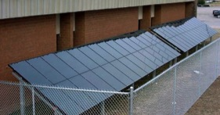
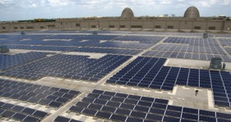
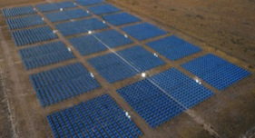
Terminology: Project Scale
Facility
Definition: single building system
Primary motivation/purpose: offset building energy use
Community
Definition: multiple buildings, campuses
Primary motivation/purpose: offset community energy costs, energy self-sufficiency
Commercial
Definition: stand-alone project
Primary motivation/purpose: revenue generation, financial self-sufficiency
Photos by NREL 09373, 18077, 13327
Notes:
I want to start this off with a real life example of important terms, which are the different scales of projects that we are using to frame our courses. In this field, there is no standard terminology for different types of projects – so we are carefully defining what we are using to cut down on confusion in this context. I should note, though, that out there in the project development world – you will hear a lot of different terms, and it is important to ask clarifying questions regarding just what kind of project someone is referring to, because of the differences in project development needs and expectations.
For our definition: Scale, in this case, doesn’t connect with project size – it’s much more about motivation. Also, there can be overlap between the types, but our primary delineators are these:
Facility-scale projects are about offsetting a facility’s energy use, for example, providing hot water for a recreation center or a solar electricity for a school.
Community-scale projects can be energy for one or many buildings, but the primary purpose is to provide self-sufficiency by offsetting energy costs to the community. In this case, it’s about reducing flow of money off the reservation or out of tribal hands. An example of this would be a hospital or a village that’s powered or heated by renewable energy.
For commercial, it’s about making money. These can be small or large projects, but the purpose is to generate revenue for the Tribe, and the electricity is sold off the reservation. Examples include a solar field or a wind farm.
This slide presents both definitions and an introduction to how we’ll introduce, point out, and define terminology throughout these courses.

Slide 12
Determining Project Scale: What is the Goal?
Goal Examples:
Offset costs
Become energy self-sufficient
Generate revenue
Facility
Savings opportunity
Utility interconnection
Community
Savings opportunity
Utility interconnection
Commercial
Offtaker options
Transmission options
Self-power opportunity
Self-power opportunity
Competing power price
1 month to 1 year to develop
3 to 5 years to develop
6 months to 2 years to develop
Notes:
The project goal is critically important to determining project scale because it has a big impact on how a project is developed. For example, what kind of permitting will need to be completed? How many people need to be involved? How much will it cost?
You can determine these by comparing the scale attributes to your Tribe’s specific goals – likely determined in your strategic energy plan or through tribal council sessions.

Slide 13
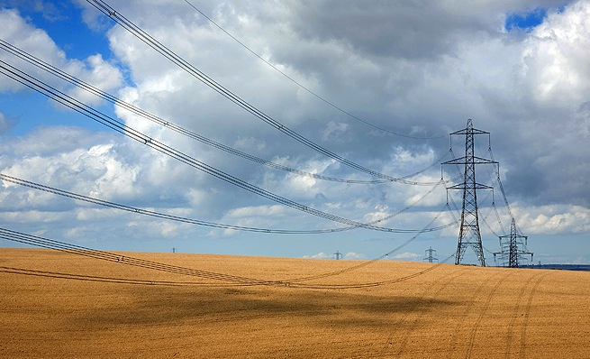
Project Development Process
Notes:
Next I’ll talk in more detail about the project development process.

Slide 14
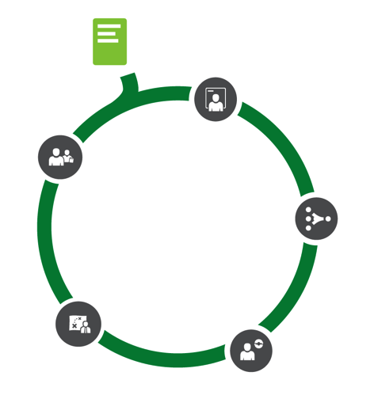
Project Development Process: What Is It?
Framework based on experience
Focuses on key decision points
Shows that project development is iterative
Emphasizes that delaying or deciding against a project that does not meet current goals is a viable outcome and option
Notes:
Here you’ll see the process we use in these courses to outline the project development process. This process was developed by the DOE Office of Indian Energy and is based on our experience in project development.
There are a number of different frameworks out there, and this is one that we have had experience with being successful in tribal project development.
We developed this one because it’s based on decision points: what are the decisions that need to be made and by which decision maker (tribal leader or project manager), and what information is necessary to make those decisions?
We also wanted to illustrate that there are a number of points in the project development process at which you can take an offramp and decide not to pursue the project.
Because this is a process, we’ve added in steps. It is important to understand, though, that the process of developing a project is actually iterative. You invest a little time or money to determine if there is potential, and if there is, you move onto the next step. There you invest a little more money and time to get more detailed information about the project and its impacts. At every point, you have an opportunity to stop the project, with minimal investment. Note that development costs do ramp up once you move on from the early development stage.
That’s an important thing to remember here: if at any stage, you are getting information that indicates that your project is not going to meet your goal, it is a valid decision to decide to delay or rethink. You want to make sure that your goals are clear from the beginning to make sure that you don’t forever put projects on hold.

Slide 15
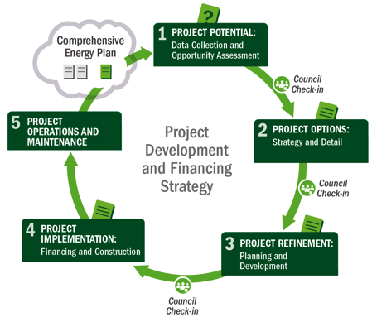
1
Potential
5 Operations & Maintenance
1
Potential
2
Options
3
Refinement
4
Implementation
Notes:
The first step in the project development process to determine the potential for a project.

Slide 16
Step 1: Potential
Purpose: Determine if the project is viable
Tasks:
Identify possible sites for project locations
Confirm renewable energy resource
Review tribal facility electric cost data, regulations, and interconnection requirements
Evaluate potential markets and paths to market for project power and renewable sales
Analyze risks: financing, permitting, construction costs
Analyze utility rules: interconnection, net metering, transmission
Notes:
When determining the potential, the key question to answer is: Is there a viable project?
You want to look for an appropriate site for the project. You may have several potential sites, but also have some areas that are really off limits for development of this kind of project. It’s important to know where the boundaries are. As part of our curriculum, the DOE Office of Indian Energy has developed a series of on-demand webinars on foundational renewable energy topics that you can watch at any time. One of these webinars goes over “Assessing Energy Resources,” which would be helpful during this step of the process because it provides information on tools you can use to identify potential project sites.

Slide 17
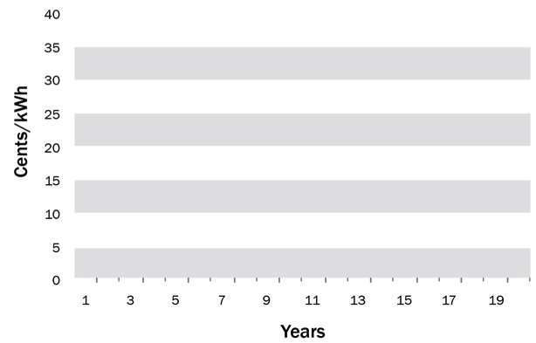
Key Concept: Levelized Cost of Energy (LCOE)
Cost of Energy Comparison
(constant demand)
Investment+O&M+Fuel costs
-------------------------------------------------
Energy produced
Renewable energy has a lower LCOE, compared to retail LCOE. How much lower depends on project specifics.
*For illustrative purposes only
Notes:
Levelized cost of energy, or LCOE, is a key concept for the project development process. Don’t panic about the equation here – the concept is what’s important.
LCOE is a calculation to capture all the costs, including capital investment, operations and maintenance, and fuel, over the life of an energy system or plant. It provides an “apples to apples” comparison for various systems with different kinds of costs.
The concept is that renewable energy technology installations are typically more expensive than what you are paying now for energy, but their costs escalate at a much slower, and more predictable rate than what you would otherwise be paying for fuel or electricity. At some point, energy from the renewable project will be less expensive than the cost of fossil fuel or electricity from the grid.
If you are buying the power for yourself – for facility or community use – you’d be comparing the retail price of utility electricity to the price of electricity from a renewable energy project. If you are selling the power on the market, you need to compare your renewable energy project LCOE to the market wholesale rate, since that’s what you’ll get for it.
What you are looking for depends on the scale of the project. You compare your LCOE for facility projects and sometimes community projects to the retail rate. It’s about what you are saving that you would otherwise purchase. With utility scale projects, it’s comparing the LCOE to the wholesale rate: can you sell it to the grid for less than what the market is currently buying other power for?

Slide 18
Levelized Cost of Energy Across Technologies

Slide 19
Step 1: Outputs
Project Scale
Resource and Market Context
Savings/Production Potential
Preliminary Sites Options
Tribal Role Options

Slide 20
2
Options
5 Operations & Maintenance
1
Potential
2
Design
3
Refinement
4
Implementation
Notes:
Now we’re going to talk about the second step in the process, which is to identify and narrow your project options.

Slide 21
Step 2: Project Options
Purpose: Narrow down the project options
Tasks:
Identify final resource
Determine tribal role/ownership structure
Clarify tax equity structure
Narrow financing options
Initiate procurement process
Identify permits
Resources:
DOE-IE renewable energy technology specific webinars:
www.energy.gov/indianenergy/resources/education-and-training.
Notes:
To narrow your project options, you need to:
Finalize the location and resource that you’ll be utilizing,
Determine what role the Tribe wants to play in the transaction (based on the project goals),
Start to narrow the financing options and tax equity structure,
Get going on procurement processes, and
Identify which permits are needed.
The advanced courses that we’ve developed, have more detail on each of these tasks. In the next 2 slides, I’ll get into a few of the most critical concepts that you need to understand at a high level.
The idea is to come out of this step being able to make the decision that the project is one that you can continue to develop. Up to this point, you’ve invested a lot of time and a little money. In the next steps you’ll probably be investing a lot more money, and it’s important at the end of this step to take stock of whether or not the project is a good idea.

Slide 22
Key Concept: Tribal Role Options
RESOURCE OWNER
Rent/Royalty $$
Access/Site Control
Payments
LENDER/CAPITAL PROVIDER
Development
PROJECT
Debt Capital $$
Equity $$
Income:
1% Pre-Flip
95% Post-Flip
ITC, PTC, MACRS
Electricity
Equity Investment $$
UTILITY/
OFFTAKER
PPA
PROJECT DEVELOPER
TAX EQUITY INVESTORS
Income:
99% Pre-Flip
5% Post-Flip
Source: Graphs adapted from ‘Renewable Energy Project Finance in the U.S.: An Overview and Midterm Outlook’ (Mintz Levin Green Paper , 2010)

Slide 23
Key Concept: Tribal Role Options
Role | Opportunity | Constraints | Comments
Project Developer | Control and self-determination of project; potential for profits | Investors require experience Development risks without portfolio diversification may not make business sense Community investment portfolio may not seek high risk/return investments | Tribal interests may be best served by outsourcing this risk Assembling a portfolio of projects is a typical method to mitigate risk
Lender/Capital Provider | Participate financially in project with lower risk | Requires ready capital May be cost prohibitive to document and manage a single debt transaction | Requires knowledge of lending practices
Investor | Provide cash for project development | Requires ready capital, or unique source of capital that provides market advantage (like NMTC) | Must compete with other investment opportunities Option for Tribes with limited lands
Resource Owner (Lessor) | Low risk, known reward, consistent income | Limited project control | Limited upside, limited risk
Offtaker | Purchasing clean energy from an “0n-site” provider; security | Limited investment, economic development, and capacity building opportunity | Implies load-serving entity (utility), or some other purchasing demand
Notes:
Talking Points:
There are many different roles that can be played.
Elaborate briefly on each:
Renewable Resource Owner - Land, rights access to sun, wind, feedstock, heat; “THE HOST”
Sponsor - Conductor/arranger of the entire transaction – “THE CHAMPION/PROMOTER”
Developer - Technical expert on secure site, choosing EPC, securing equipment & financing
Off-taker - Recipient of energy from project
Investor/Financier - Equity, Debt, Tax Equity
KEY MESSAGE: The tribe can play one of several of these depending on the circumstances.

Slide 24
Key Concept: Tax Equity Partnerships
Tribe can benefit from tax equity incentives without being taxable
Tax equity can lower capital costs for a qualifying project significantly (40%-50%)
Tribe benefits by either reduced electricity costs from the renewable project, or offering a more competitive price for energy or renewable energy attributes (commonly referred to as “RECs”) from the project
Tribes can partner with third-party tax investors and/or developers to gain this advantage
Notes:
Let’s talk for a few minutes about the Key Concept of Tax Equity Partnerships.
The reason this is important is because the federal government offers tax incentives for renewable energy development, sometimes to the tune of 30-50%.
This works because the tax equity partner passes through the equivalent savings of the tax credit value through reduced electricity costs or a more competitive price for energy.
Tribes still have the option to own the project after the useful tax credit life, and most agreements with a partner outline the specifics of the ownership transfer.
You CAN develop a project without a tax equity partner. However, it is unlikely that you’ll have a situation in which the economics make sense, so there would have to be another compelling reason to skip this partnership type and eschew the tax credit opportunity.
There is more information on tax equity partnerships and how they work in the advanced series of courses, as well as in the community- and commercial-scale focused webinars.

Slide 25
Step 2: Outputs
Decision on resource type
Decision on ownership structure
Understanding the permit needs and process
Narrowing of technology options

Slide 26
3
Refinement
5 Operations & Maintenance
1
Potential
2
Options
3
Refinement
4
Implementation
Notes:
Once you’ve narrowed the project options and determined that the project is still viable given your goals and the project economics, you can start to refine it. This is a huge effort, and for most larger projects, is done in partnership with a project developer (who may or may not be the tax equity partner).

Slide 27
Step 3: Project Refinement
Purpose: Make decisions
Tasks:
Finalize ownership structure and project team identification
Finalize permitting (including environmental reviews), interconnection
Finalize technology, financing, and development costs
Notes:
In this step, there are a lot of decisions to be made by the tribal leaders. For example:
Will there be a tax equity partnership?
Will there be a project developer? If so, who? This is done through a procurement process, and we talk more about this in our advanced series of webinars. Also, the DOE Office of Indian Energy resource library contains links to useful documents that can assist in the design and roll out of these procurement efforts, so that you are most likely to get a good deal.
Are the permits in motion? This can also be the job of the developer, if you go that direction.
What are the real, brass tacks costs and financing options for this project (that’s developed by the staff), and which one will you go with (determined by the leadership)?
We’ve provided more information on the mechanics of step 3 in our community- and commercial-scale webinars.

Slide 28
Step 3: Project Refinement Example
Site | Resource | Off-Take | Permits | Technology | Team | Capital
Securing Site: No Site, No Project | Engineering Assessment (Input) | Power Purchases: Off-take Contract – (Revenue) | Anything that can stop a project if not in place… | Engineered System (Output) | Professional, Experienced, Diverse | Financing Structure
Site control Size and shape Location to load and T&D Long-term control Financial control Clear title Lease terms Collateral concerns Environmental Access O&M access Upgradable | Volume/ Frequency Variability Characteristics (power/speed) 24-hour profile Monthly, seasonal and annual variability Weather dependence Data history Std. Deviation Technology suitability | Credit of counterparty Length of contract Terms and conditions Reps and warranties Assignment Curtailment Interconnection Performance Enforcement Take or pay Pricing and terms | Permitting/ entitlements Land disturbance Environmental Cultural impacts Resource assessments Wildlife impacts Habitat NEPA, EIS Utility inter-connection Other utility or PUC approvals Lease and/or ROW Approvals | Engineering design plans Construction plans Not generic solar panel and inverter Engineered resource/ conversion technology/ balance of system designs Specifications Bid set | Business management Technical expertise Legal expertise Financial expertise (including Tax) Transmission interconnection expertise Construction/ contract management Operations Power marketing/ sales | Development equity Project equity Project debt Mezzanine or bridge facility Tax equity Grants, rebates, other incentives Environmental attribute sales contracts (RECs) Bond finance Non-recourse project finance
Tribal land site secured for commercial-scale solar PV project: 200 acres with transmission access | Solar resource data favorably evaluated | Electric utility offtaker identified and contracted | Necessary permits secured including interconnection agreement | System design prepared to bid | Team identified and engaged | Determine finance structure
Framework: NREL SROPPTTCTM

Slide 29
Step 3: Outputs
Proposed financing/commitments and organization structure
Detailed economic models
Vendors selected
Completed environmental reviews and finalized permits
Offtake and transmission/interconnection agreement

Slide 30
4
Implementation
5 Operations & Maintenance
1
Potential
2
Options
3
Refinement
4
Implementation
Notes:
This Implementation step when you get to actually see the construction of the project happen.

Slide 31
Step 4: Implementation
Purpose: Complete physical construction of project
Tasks:
Finalize project agreements
Finalize vendor contracting process
Finalize pre-construction tasks
Complete construction and equipment installation
Complete interconnection
Commission project leading to commercial operations
Output:
Completed project (commercial operation)
Notes:
In this step, which can be among the longer of the steps, you finalize all the partnerships and technology agreements, complete the interconnection with the utility, and get all the financing in order and executed so you can build the project.
When the project implementation is done, and this is often done by the developer partner, if you have one, it’s commissioned and operation begins.

Slide 32
5 Operations & Maintenance
5 Operations & Maintenance
1
Potential
2
Options
3
Refinement
4
Implementation
Notes:
Finally, the project is up and running! Now you have to maintain it.

Slide 33
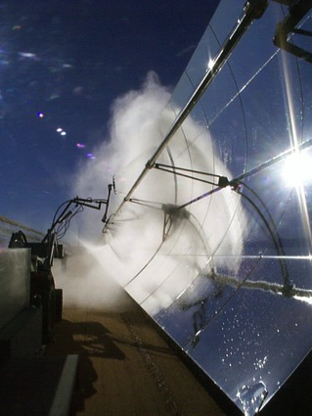
Step 5: Operations and Maintenance
Purpose: Implement operations and maintenance plan (O&M) (contract or self)
O&M Costs:
Equipment maintenance and upkeep
Inverter replacement
Insurance
Labor and staffing
Extended warranty agreements.
Photo by NREL 14952
Notes:
Operations and maintenance, or O&M, for renewable power plants is less than fossil plants because there typically is no fuel cost. However, there are other maintenance costs to consider, including:
Cleaning,
Mechanical functionality,
Insurance, and
For solar power projects, inverter replacement.
The developer partner will often have this in their proposal, if you choose to pursue one.

Slide 34
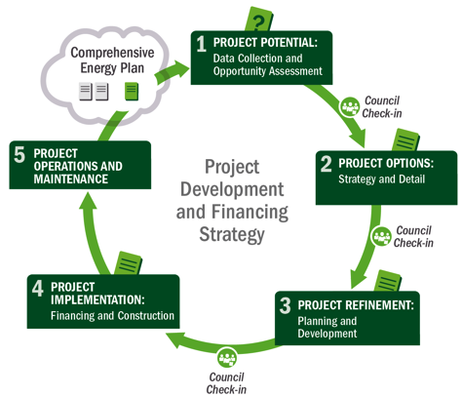
Not Quite Done!
Check back in with planning document – update as necessary
Identify next potential project from plan
Notes:
Now that the facility is operating and being maintained, you may think that’s it’s a done deal, but it’s not!
It’s now a part of your energy and financial portfolio. Integrating this project into your energy planning process is critical to making sure that what you learned from this project is carried into future projects.
From there, you can follow this same cycle as you approach additional potential projects that you’ve identified in your comprehensive energy plan.

Slide 35
Summary of Actions by Step
5 Operations & Maintenance
1
Potential
2
Options
3
Refinement
4
Implementation
Data Collection and Opportunity Assessment
Options and Strategies
Planning and Development
Financing and Construction
Step 1: Gather all relevant data in order to make first pass at potential project; understand tribal role options
Step 2: Estimate value to Tribe; begin to identify offtakers, partners, vendors
Step 3: Finalize economic assumptions and roles, interconnection and offtake agreements, partnerships, ownership structure
Step 4: Financial close and construction, vendor contracting completion, project commercially delivered
Step 5: Maintenance plan implementation
Celebrate!
Notes:
This has been a VERY high level overview of this project development framework. It’s very important to remember that this process is iterative and involves increasing refinement of information in order to know if the project is going to achieve the Tribe’s goals.

Slide 36
Thank you
These courses were designed in coordination with Tracey LeBeau and Pilar Thomas of the DOE Office of Indian Energy, by a team including: Dan Beckley, Stacy Buchanan, Elizabeth Doris, Mike Elchinger, Sara Farrar-Nagy, Bill Gillies, Paul Schwabe, Bob Springer, and Rachel Sullivan of the National Renewable Energy Laboratory; Joe Cruz and Matt Ferguson of Cohn Reznick; Paul Dearhouse of Dearhouse Consulting Group; and Carolyn Stewart of Red Mountain Energy Partners.
Questions/Comments: indianenergy@hq.doe.gov
For More Information: www.energy.gov/indianenergy
Additional Courses: www.nterlearning.org
Notes:
Thank you for your interest in this overview of the essential concepts for renewable energy project development and financing. For more information, including our complete list of project development and financing webinars, renewable energy technology foundational webinars, Energy Resource Library, and more please visit the DOE Office of Indian Energy website at www.energy.gov/indianenergy. You can also access these webinars directly from the National Training and Education Resource Center at: www.nterlearning.org.
This work was funded by the DOE Office of Indian Energy Policy and Programs, and developed through a partnership between the DOE Office of Indian Energy, the National Renewable Energy Laboratory, Cohn Reznick, Red Mountain Energy Partners, and Dearhouse Consulting Group.

Slide 37
INFORMATION ON THE CURRICULUM PROGRAM & OFFERINGS

Slide 38
Curriculum Structure & Offerings
Foundational Courses
Leadership & Professional Courses
Overview of foundational information on renewable energy technologies, strategic energy planning, and grid basics
Covers the components of the project development process and existing project financing structures

Slide 39
Foundational Courses
Energy Basics
Assessing Energy Resources
Electricity Grid Basics
Renewable Energy Technology Options
Biomass
Strategic Energy Planning
Wind
Solar
Geothermal
Hydroelectric
Building Heat & Hot Water
All courses are presented as 40-minute Webinars online at
www.energy.gov/indianenergy

